Slide 1

Technological Forecasting Based on Spectral Clustering for Word Frequency Time Series
Joint Workshop of the 5th Extraction and Evaluation of Knowledge Entities from Scientific Documents (EEKE2024) and the 4th AI + Informetrics (ALL2024)
Han Huang¹, Xiaoguang Wang^{2,3} and Hongyu Wang^{1,*}
¹ School of Management, Wuhan University of Technology, Wuhan, China, 430070
² School of Information Management, Wuhan University, Wuhan, China, 430072
³ Institute of Big Data, Wuhan University, Wuhan, China, 430072

Slide 2
01.
Background and overview
02.
Methodology
03.
Experiments and result analysis
04.
Discussion and conclusion
2

Slide 3


Joint Workshop of the 5th Extraction and Evaluation of Knowledge Entities from Scientific Documents (EEKE2024) and the 4th AI + Informetrics (ALL2024)
01
Background and overview
3

Slide 4



Background
The significance of technological forecasting
1
Today's socio-economic advancement relies on technological innovation, with strategic planning and forecasting becoming crucial for future competitiveness. In this context, the significance of technological forecasting has become increasingly prominent.
Automatic identification of technical stages
2
Using big data analytics to analyze scientific texts and identify technological trends, supplemented by expert judgment, is vital for effective technological forecasting. A key challenge is automating the identification of technology evolution stages.
Temporal trend of word frequency
3
Word frequency serves as a fundamental indicator reflecting the popularity and activity level of scientific and technological fields, with its temporal trends effectively revealing the dynamics of scientific and technological development.
4

Slide 5
Paper Work
Introducing Time Trend Clustering Model (TTCM) and employing this model to analyze word frequency time series for technological forecasting
To verify the model's effectiveness, this study first applied the TTCM model to cluster standard time series datasets from the UCI repository, demonstrating TTCM's capability to effectively differentiate time series data with similar evolution trends.
Taking the LIS discipline as an example, this study used the TTCM model to analyze the trends in word frequency time series, identifying four types of word frequency temporal trends: burst, increasing, decreasing, and high-frequency fluctuation. Based on these findings, the study analyzed the future research trends in the LIS discipline, further validating the scientificity and applicability of the TTCM model in technological forecasting.
5

Slide 6
Joint Workshop of the 5th Extraction and Evaluation of Knowledge Entities from Scientific Documents (EEKE2024) and the 4th AI + Informetrics (ALL2024)
02
Methodology
6

Slide 7
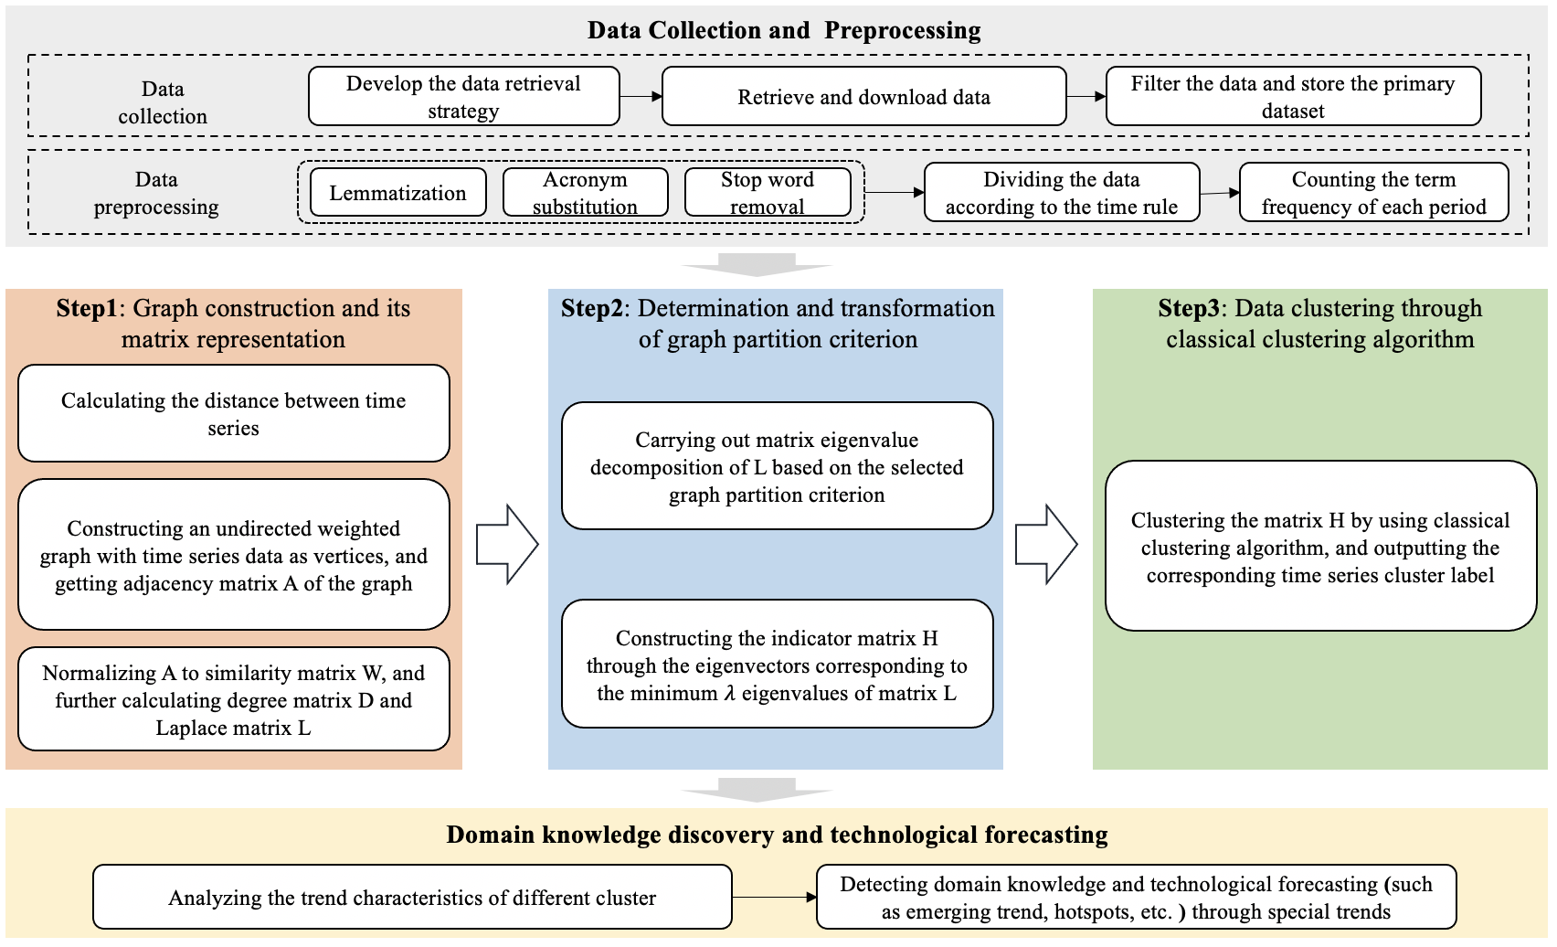
Model definition
7

Slide 8
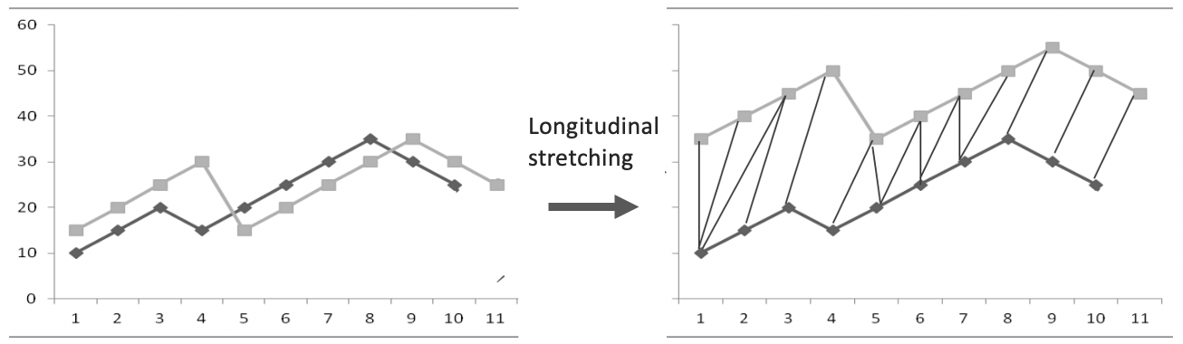
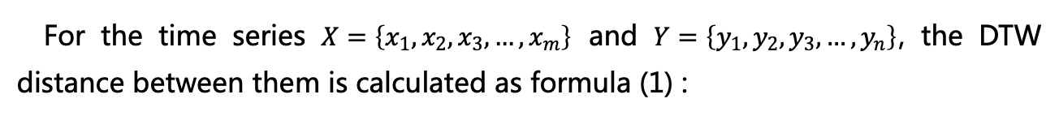
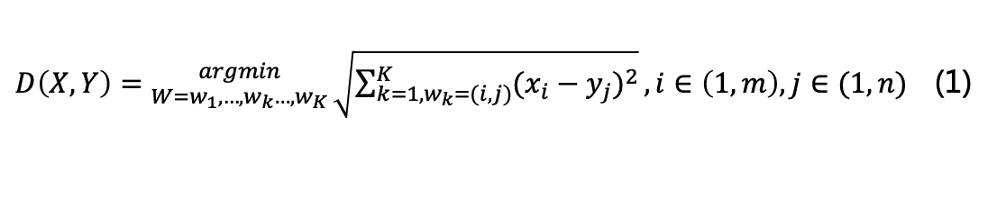
Graph construction and its matrix representation
In this study, the time series is regarded as vertices and the Dynamic Time Warping (DTW) distance between time series is used as edge weight to construct an adjacency matrix A
The matching principle of DTW algorithm
For the time series $X=\left\{x_{1},x_{2},x_{3},…,x_{m}\right\}$ and $Y=\left\{y_{1},y_{2},y_{3},…,y_{n}\right\}$, the DTW distance between them is calculated as formula (1) :
$D\left(X,Y\right)={argmin \atop W=w_{1},…,w_{k}…,w_{K}}\sqrt{\sum_{k=1,w_{k}=(i,j)}^{K}{{(x_{i}−y_{j})}^{2}}},i∈\left(1,m\right),j∈(1,n)$ (1)
Where, 𝑤_𝑘=(𝑖,𝑗) represents that the ith data point of 𝑋 and the jth data point of 𝑌 in the path k are corresponding points, and 𝑊 is the optimal path, which can minimize the value of 𝐷(𝑋,𝑌)
8

Slide 9
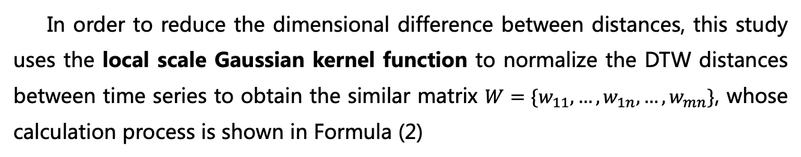
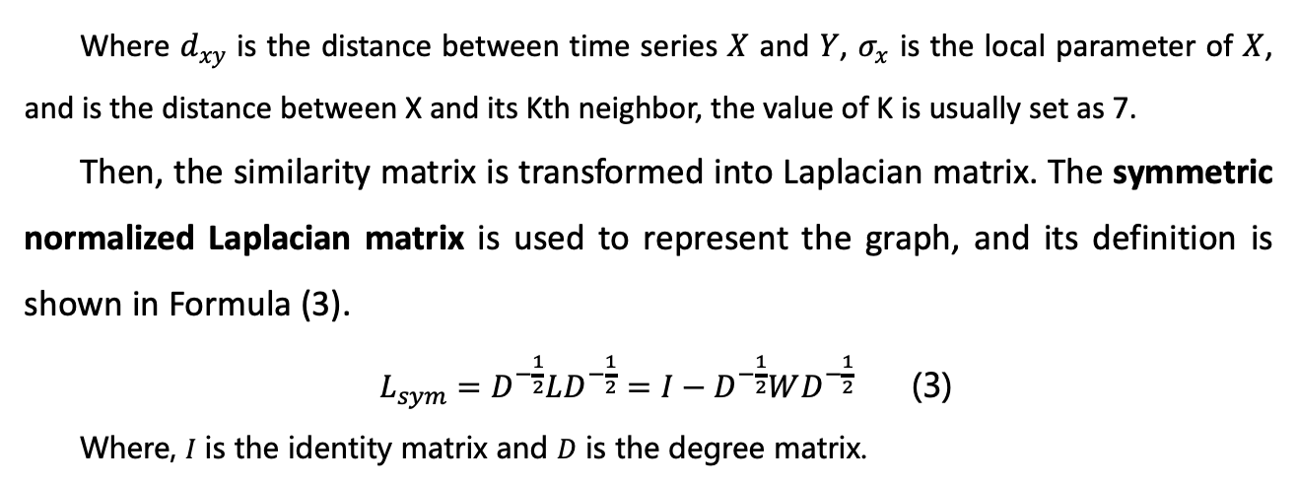
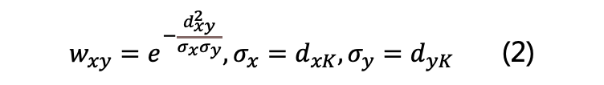
Graph construction and its matrix representation
In order to reduce the dimensional difference between distances, this study uses the local scale Gaussian kernel function to normalize the DTW distances between time series to obtain the similar matrix $W=\{w_{11},…,w_{1n},…,w_{mn}\}$, whose calculation process is shown in Formula (2)
$w_{xy}=e^{−\frac{d_{xy}^{2}}{σ_{x}σ_{y}}},σ_{x}=d_{xK},σ_{y}=d_{yK}$ (2)
Where $d_{xy}$ is the distance between time series $X$ and $Y$, $σ_{x}$ is the local parameter of $X$, and is the distance between X and its Kth neighbor, the value of K is usually set as 7.
Then, the similarity matrix is transformed into Laplacian matrix. The symmetric normalized Laplacian matrix is used to represent the graph, and its definition is shown in Formula (3).
$L_{sym}=D^{−\frac{1}{2}}LD^{−\frac{1}{2}}=I−D^{−\frac{1}{2}}WD^{−\frac{1}{2}}$ (3)
Where, 𝐼 is the identity matrix and 𝐷 is the degree matrix.
9

Slide 10
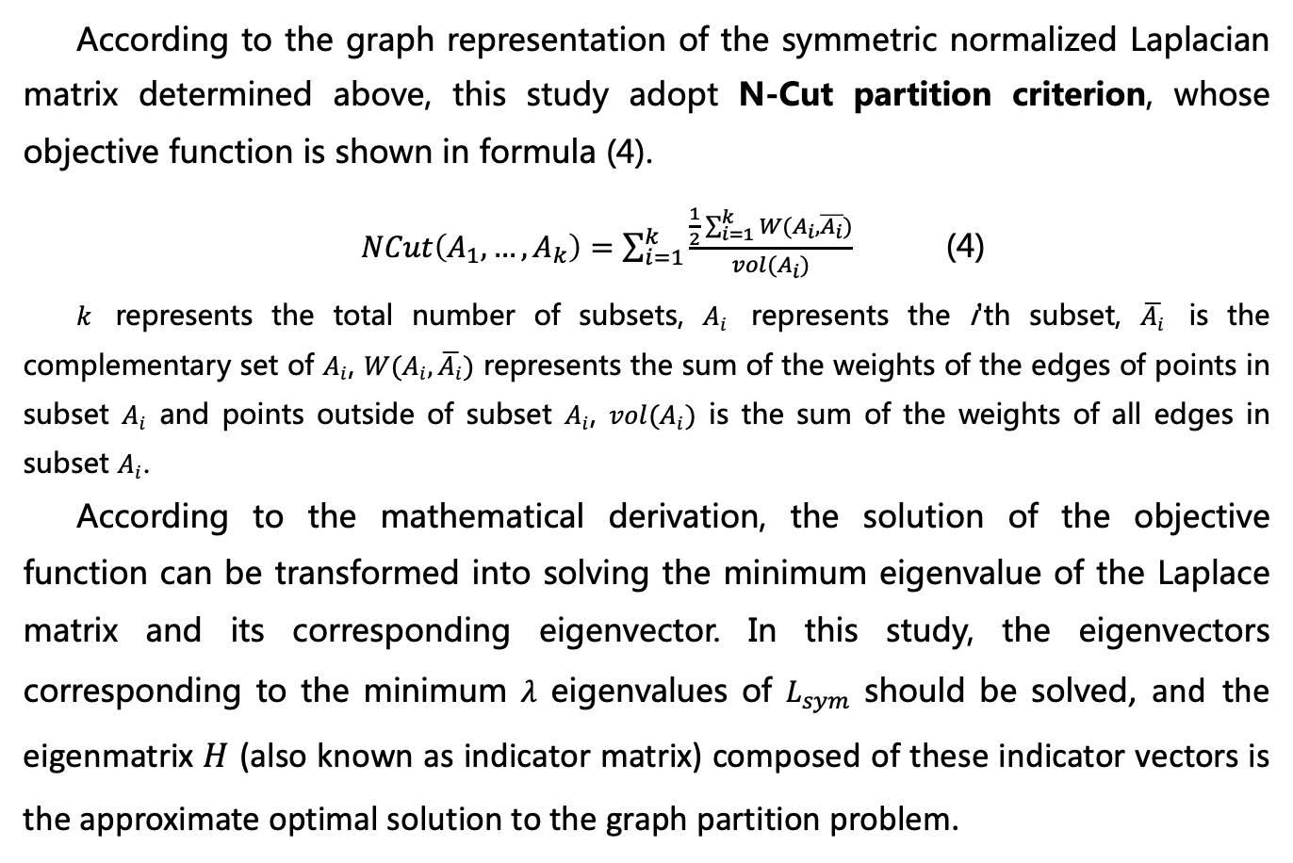
The determination and transformation of graph partition criterion
According to the graph representation of the symmetric normalized Laplacian matrix determined above, this study adopt N-Cut partition criterion, whose objective function is shown in formula (4).
$NCut\left(A_{1},…,A_{k}\right)=\sum_{i=1}^{k}{\frac{\frac{1}{2}\sum_{i=1}^{k}{W(A_{i},\overline{A_{i}})}}{vol(A_{i})}}$ (4)
$k$ represents the total number of subsets, $A_{i}$ represents the i'th subset, $\overline{A_{i}}$ is the complementary set of $A_{i}$, $W(A_{i},\overline{A_{i}})$ represents the sum of the weights of the edges of points in subset $A_{i}$ and points outside of subset $A_{i}$, $vol(A_{i})$ is the sum of the weights of all edges in subset $A_{i}$.
According to the mathematical derivation, the solution of the objective function can be transformed into solving the minimum eigenvalue of the Laplace matrix and its corresponding eigenvector. In this study, the eigenvectors corresponding to the minimum $λ$ eigenvalues of $L_{sym}$ should be solved, and the eigenmatrix $H$ (also known as indicator matrix) composed of these indicator vectors is the approximate optimal solution to the graph partition problem.
10

Slide 11
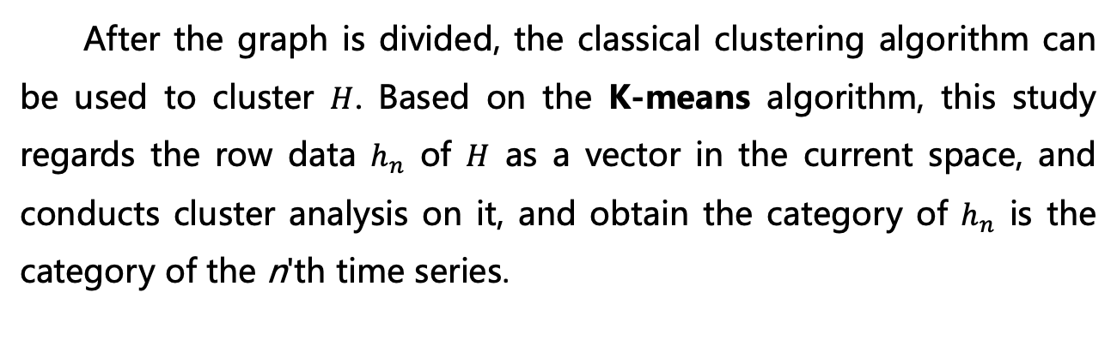
Data clustering through classical clustering algorithm
After the graph is divided, the classical clustering algorithm can be used to cluster $H$. Based on the K-means algorithm, this study regards the row data $h_{n}$ of $H$ as a vector in the current space, and conducts cluster analysis on it, and obtain the category of $h_{n}$ is the category of the n'th time series.
11

Slide 12
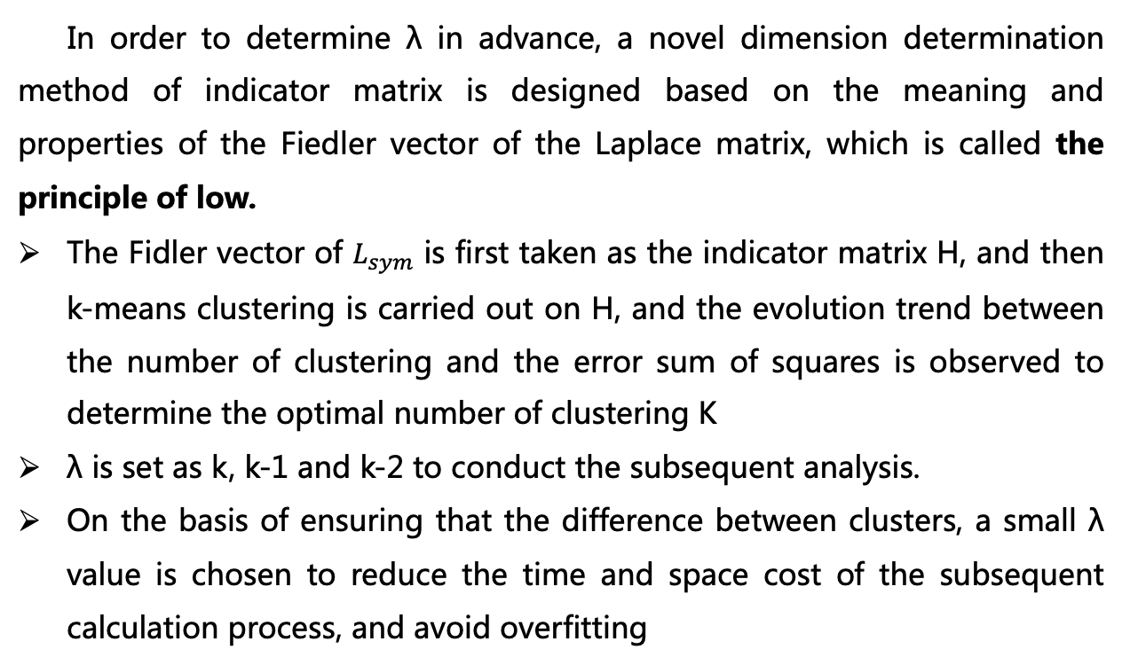
Algorithm parameter determination
In order to determine λ in advance, a novel dimension determination method of indicator matrix is designed based on the meaning and properties of the Fiedler vector of the Laplace matrix, which is called the principle of low.
The Fidler vector of $L_{sym}$ is first taken as the indicator matrix H, and then k-means clustering is carried out on H, and the evolution trend between the number of clustering and the error sum of squares is observed to determine the optimal number of clustering K
λ is set as k, k-1 and k-2 to conduct the subsequent analysis.
On the basis of ensuring that the difference between clusters, a small λ value is chosen to reduce the time and space cost of the subsequent calculation process, and avoid overfitting
12

Slide 13
Joint Workshop of the 5th Extraction and Evaluation of Knowledge Entities from Scientific Documents (EEKE2024) and the 4th AI + Informetrics (ALL2024)
03
Experiments and result analysis
13

Slide 14
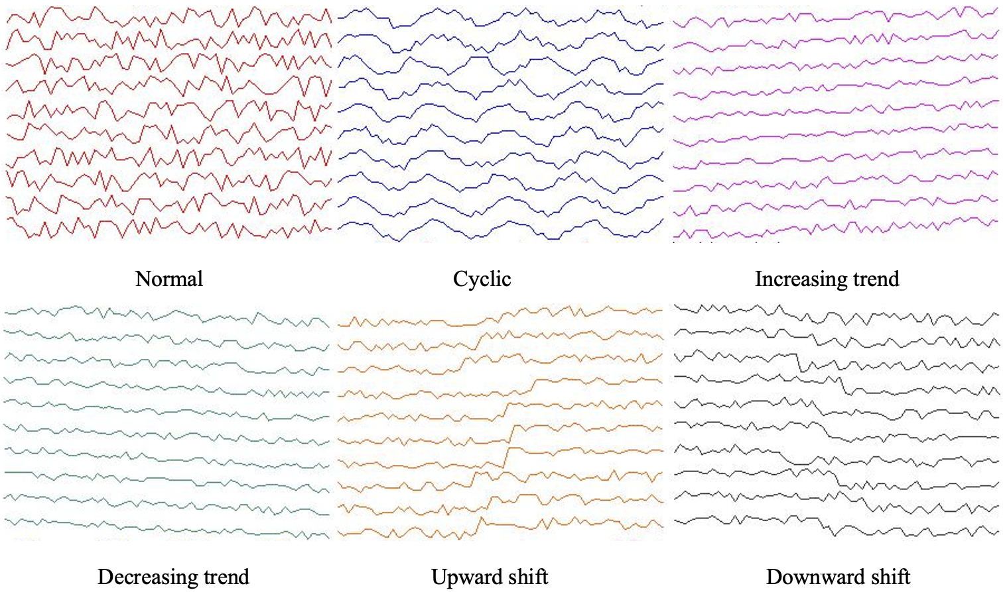
Model validation through time series standard dataset
To verify the efficiency of TTCM in time series clustering, the standard time series dataset in the Knowledge Discovery Archive of UCI is used to test the model. There are 600 pieces of data in the time series dataset, and every 100 pieces represent a trend type, which are marked as normal, cyclic, increasing trend, decreasing trend, upward shift, and downward shift.
14

Slide 15
Model validation through time series standard dataset
And the Power Iteration Clustering (PIC) model and the Affinity Propagation (AP) clustering model, which are also based on graph theory, are selected as the baseline to compare the model recognition effects.
According to the trends of the test dataset, the clustering number of TTCM model, PIC model and AP model is set to 6, and the maximum number of iterations is set as 30. Meanwhile, in the TTCM model, λ is set to 4,5, and 6.
Model | TTCM (λ = 4) | TTCM (λ = 5) | TTCM (λ = 6) | PIC | AP
Number | 406 | 578 | 492 | 200 | 419
P | 64.02% | 96.63% | 81.14% | 24.44% | 70.48%
R | 67.67% | 96.33% | 82.00% | 33.33% | 69.83%
F1 | 64.18% | 96.33% | 81.44% | 27.50% | 67.11%
15

Slide 16
Model validation through time series standard dataset
Specific to each category, the recognition results of TTCM when λ= 5
Model Actual | Normal | Cyclic | Increasing trend | Decreasing trend | Upward shift | Downward shift | Recall
Normal | 98 | 0 | 2 | 0 | 0 | 0 | 98.00%
Cyclic | 0 | 100 | 0 | 0 | 0 | 0 | 100.00%
Increasing trend | 0 | 0 | 100 | 0 | 0 | 0 | 100.00%
Decreasing trend | 0 | 0 | 0 | 99 | 0 | 1 | 99.00%
Upward shift | 1 | 0 | 11 | 0 | 88 | 0 | 88.00%
Downward shift | 0 | 0 | 0 | 7 | 0 | 93 | 93.00%
Precision | 98.99% | 100.00% | 88.50% | 93.40% | 100.00% | 98.94% | F₁ = 0.9633
TTCM can effectively distinguish the six types of trends in the test data set, and only errors appear in the recognition of a small number of increasing and upward shifts and decreasing and downward shifts.
16

Slide 17
Temporal trend clustering through word frequency time series
Taking LIS as an example, this study collected data of 38,932 papers published in SSCI journals from 2011 to 2020. After preprocessing, the number and frequency of keywords in each year are statistically.
Year | Number of papers | Number of keywords | Frequency of keywords | Average word frequency
2011 | 3298 | 6324 | 10706 | 1.69
2012 | 3414 | 7125 | 12230 | 1.72
2013 | 3618 | 8087 | 13876 | 1.72
2014 | 3732 | 8267 | 14089 | 1.7
2015 | 3822 | 8806 | 15546 | 1.77
2016 | 4155 | 10082 | 17922 | 1.78
2017 | 4139 | 10156 | 17273 | 1.7
2018 | 4079 | 10632 | 17894 | 1.68
2019 | 4205 | 11034 | 18917 | 1.71
2020 | 4470 | 12270 | 21215 | 1.73
A total of 1,952 high-frequency words from 2011 to 2020 were screened for cluster analysis
Following the principle of low, the study set λ to 3 and the number of clusters k to 5 for the TTCM
17

Slide 18
Temporal trend clustering through word frequency time series
In the clustering results of temporal trend of word frequency, the first kind of trend can be summarized as the burst trend. The obvious characteristic of this kind of trend is that the word frequency of keywords is low in the early and middle period of the whole-time span, but the term frequency shows a trend of rapid rise in the middle and later periods. A total of 30 keywords are clustered as such trend.
Part of words with burst trend in word frequency series (emerging words)
18

Slide 19
Temporal trend clustering through word frequency time series
In the word frequency series of keywords, the second trend can be classified as the increasing trend. The word frequency series of this kind of trend shows a general trend of fluctuation increase in the whole-time span, but the word frequency remains at the low level in the whole-time span. There are 177 keywords with the increasing trends.
Part of words with increasing trend in word frequency series (hotspot words)
19

Slide 20
Temporal trend clustering through word frequency time series
In the clustering results of temporal trend of word frequency, the third kind of trend can be summarized as the high-frequency fluctuation trend. The obvious characteristic of this kind of trend is that the word frequency of keywords remains at a high level in the whole-time span, and the word frequency fluctuates slightly with the passage of time. A total of 30 keywords are clustered as such trend.
Part of words with high-frequency fluctuation trend in word frequency series (label words)
20

Slide 21
Temporal trend clustering through word frequency time series
In the word frequency series of keywords, the fourth trend can be classified as the decreasing trend. The word frequency series of this kind of trend shows a general trend of fluctuation decrease in the whole-time span, and the word frequency remains at the low level in the whole-time span. There are 69 keywords with the decreasing trends.
Part of words with decreasing trend in word frequency series (fading words)
21

Slide 22
Temporal trend clustering through word frequency time series
TTCM model is highly effective in identifying emerging words across various disciplines that have suddenly burst onto the scene, successfully capturing the rising trend of keyword frequencies towards the end of the time span.
Within the set of keywords exhibiting an upward trend, the model accurately identified research hotspots that are gradually gaining widespread attention among LIS scholars.
For the keywords identified by the model as having high-frequency fluctuations, their frequency levels consistently remained high, often signifying core research sub-fields or topics within the domain.
Conversely, the model effectively reflected keywords in decline, indicating words that are gradually fading from the focal interest of scholars in the discipline.
22

Slide 23
Technical forecasting based on temporal trend of word frequency
Trend | Research questions/objects | Research methods/technologies
Burst | 17 Electronic Health Records Covid-19 Digital Transformation Coronavirus Journalism | 13 Machine Learning Artificial Intelligence Deep Learning Blockchain Neural Network
Increasing | 117 Privacy Research Evaluation Gender Scholarly Communication Higher Education | 60 Social Network Analysis Big Data Classification Altmetrics Sentiment Analysis
Decreasing | 57 Internet E-government Digital Library Web2.0 Blog | 12 Focus Group Semistructured Interviews Nanotechnology Citation Distribution Microsimulation
High-frequency fluctuation | 18 Social Media Academic Library Information Literacy China Collaboration | 12 Bibliometrics Qualitative Citation Analysis Case Study Information Retrieval
Total | 209 | 97
23

Slide 24
Technical forecasting based on temporal trend of word frequency
Many keywords show an increasing trend, but their research coverage might not expand due to technological literature inflation. If new research methods or areas don't emerge, these keywords could start to decline as scholars shift their focus.
Quantitatively, less than half of fading keywords are declining compared to those trending upwards, possibly due to literature inflation from technological advances. Simultaneously, keywords related to questions/objects are declining more than those related to methods/technologies, likely because methods and technologies are more broadly applicable and remain in use despite changing research topics.
Among the emerging words with burst trend, although there are more questions/objects words in absolute number, the relative proportion of methods/technologies words is relatively high, indicating that researchers have paid attention to some new research objects and introduced more emerging technologies.
24

Slide 25
Technical forecasting based on temporal trend of word frequency
Technologies such as focus groups, semi-structured interviews, and microsimulation, primarily targeting small-scale data samples, exhibit a decreasing trend, while big data analysis techniques such as artificial intelligence, machine learning, deep learning, social network analysis, and sentiment analysis demonstrate a burst or increasing trend. This reflects the progress and evolution of research methods and technologies in LIS, with an increasing number of researchers adopting emerging technologies to process and analyze information to gain deeper and broader insights. Simultaneously, the application of emerging technologies also reflects the transformation of research content in the LIS field towards quantitative analysis, large-scale data processing, and deep data mining.
25

Slide 26
Joint Workshop of the 5th Extraction and Evaluation of Knowledge Entities from Scientific Documents (EEKE2024) and the 4th AI + Informetrics (ALL2024)
04
Discussion and conclusion
26

Slide 27
Discussion
Experiments on standard time series data sets show that the TTCM model proposed in this study can automatically cluster time series with similar trends. Applying it to the analysis of word frequency time series, TTCM model also successfully identified four different types of keywords, and further combined with term functions, it has great reference and guidance value for the predictive analysis of subject areas.
TTCM is essentially a clustering analysis model for time series. Therefore, the application is not limited to word frequency time series. Subsequently, it can be applied to the comprehensive analysis of time series data from literature, patents, network news, social media, stock securities and other sources, so as to provide reference and guidance for the organizational decision-making of government, industry and enterprise.
The TTCM model identifies evolution trends in time series, which can be integrated with machine learning and deep learning models to automate and predict large-scale time series trends, identifying emerging research and technology areas.
27

Slide 28
Conclusion
Conclusion
Limitation
Future work
This study introduces the TTCM model for clustering time series trends in technological forecasting, combining DTW with spectral clustering to group similar time series. Initially tested on UCI repository datasets, TTCM is proved effective in differentiating time series trends. Applied to the LIS discipline, it identified four different word trends, demonstrating its utility in domain knowledge discovery and forecasting.
Only ten years of data were selected for analysis
The case study is limited to the LIS domain
The analysis in this study is limited to word perspectives, without considering interrelations among keywords in the topic dimension
Addressing the shortcomings mentioned above
Incorporating other data sources
Solidifying these trends into pattern features and further integrating them with classification models
28

Slide 29
Joint Workshop of the 5th Extraction and Evaluation of Knowledge Entities from Scientific Documents (EEKE2024) and the 4th AI + Informetrics (ALL2024)
Thank you for your listening!
Han Huang
huanghan@whu.edu.cn

